Slide 1
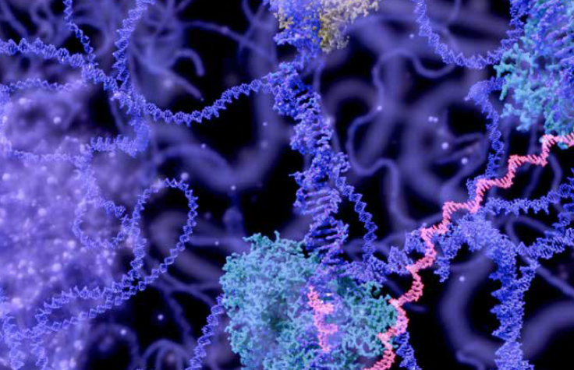


Experimental Design
For transcriptomics analysis
Tijs Bliek
Plant Development & Genetics Swammerdam Institute for Life Sciences (SILS)

Slide 2
Statistical refresher
While most scientists would rapidly dive into RNA-seq sample preparation and searching for a sequencing provider, it is crucial to spend enough time to refresh one’s statistical knowledge and embrace good experimental design practices. After all, a typical RNA-seq experiment is also an experiment like any other.
Statistics are often overlooked (at best) or avoided (very often) by wet-lab biologists since it is often thought of being both complex and boring. Yet, this episode will hopefully prove that is can be simply explained and that a few pragmatic considerations will usually save a considerable amount of time and money.

Slide 3
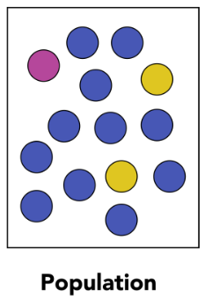
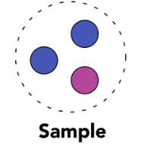
Population and sample
A sample is a subset of that population that must be representative of that population. It therefore has to be selected randomly from the whole population.

Slide 4
Population and sample
Data collection consists of measuring the values of one or several variables for each member of the population. For instance, you could measure the height and weight of people.
If you are working on the height of the population from the Netherlands, then your population would be “all people in the Netherlands” and your variable would be “height”. A sample is a subset of that population that must be representative of that population. It therefore has to be selected randomly from the whole population.

Slide 5
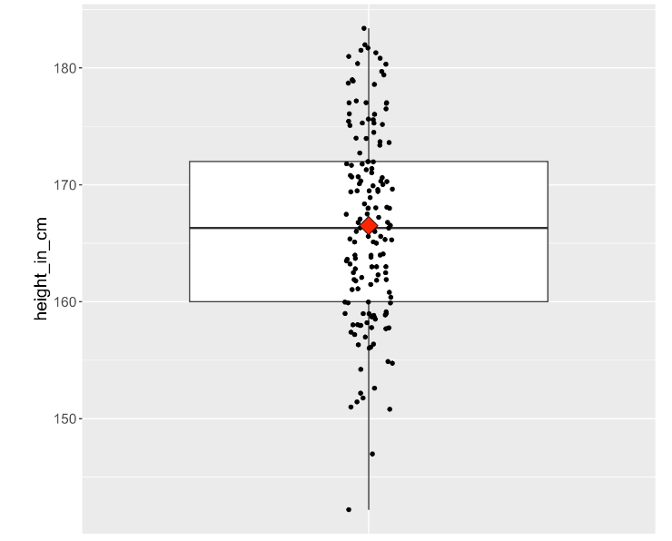
Central tendency and spread
Here is a boxplot made from the world’s population heights (one point is the average height in one country).
the measures of central tendency and spread are of interest to us because they will also have important consequences for RNA-seq.

Slide 6
Hypothesis test
These notions of central tendency and spread are vital to the rest of this episode. In your RNA-seq journey, you will work with thousands of genes. But before you do so, it is important to understand how statistical tests and the infamous p-values are computed by working with one gene.

Slide 7
Hypothesis test
you are studying a plant gene called “heat stress transcription factor A-2” (HSFA2) whose expression could be increased by heat stress
You therefore measure this gene transcript level in two conditions: normal and heat stressed.
H₀ hypothesis or the null hypothesis
“The average HSFA2 gene expression is the same in normal conditions than under heat stress in my Arabidopsis seedlings”.
H₁ hypothesis or alternative hypothesis
“The average HSFA2 gene expression is different under heat stress compared to normal conditions in my Arabidopsis seedlings”.

Slide 8
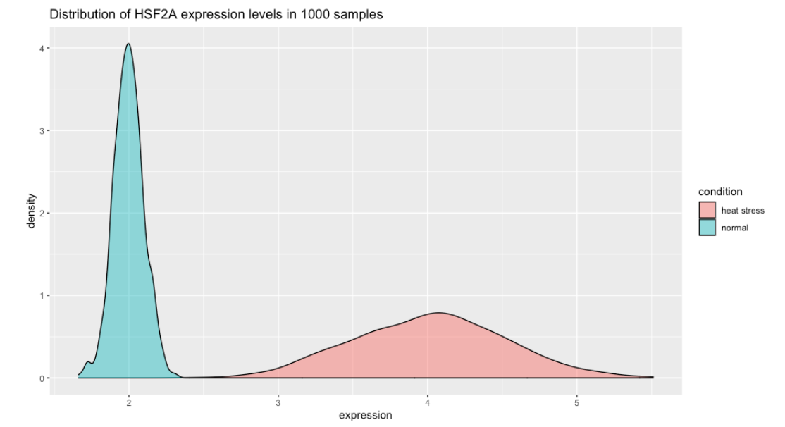
perform a Student t-test to test the null hypothesis H₀ to see if the difference is significant (based on P-value)

Slide 9
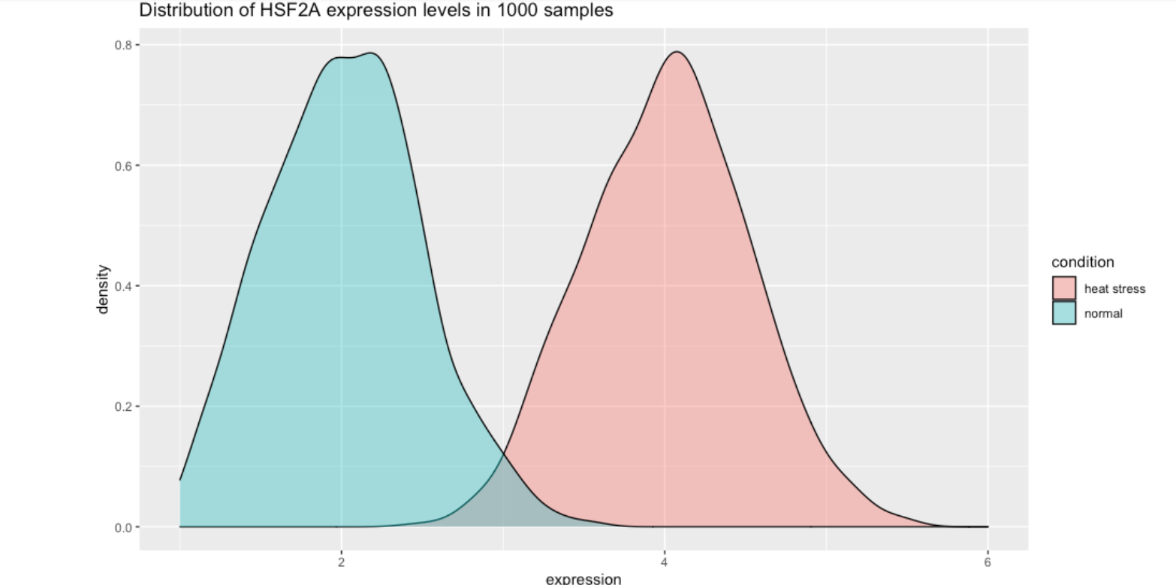
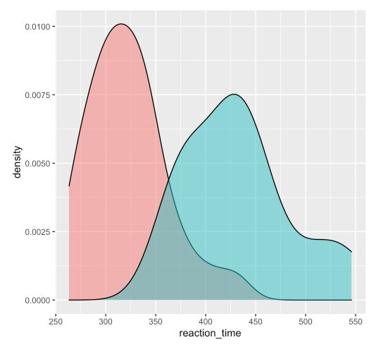
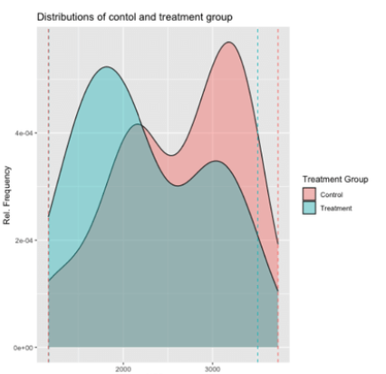
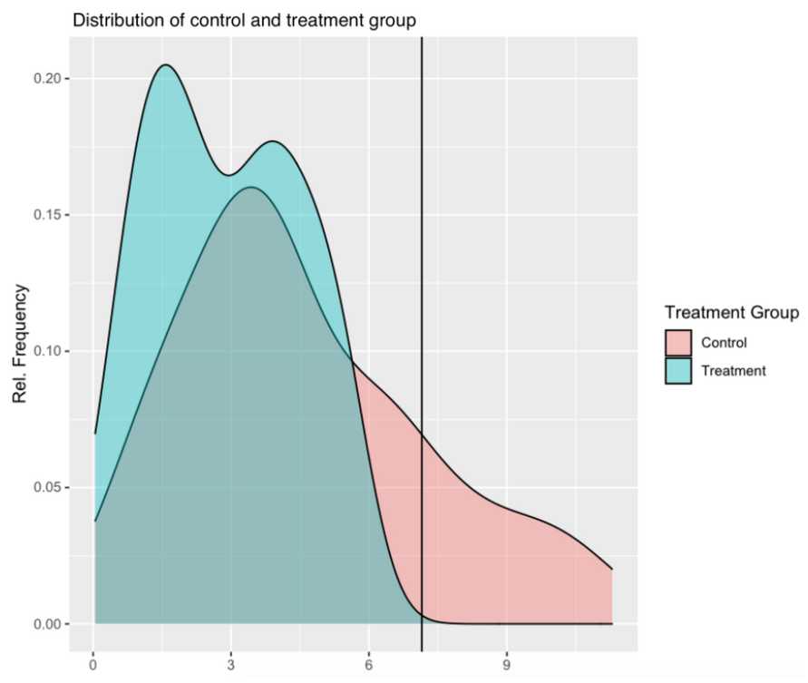
perform a Student t-test to test the null hypothesis H₀ to see if the difference is significant (based on P-value)

Slide 10
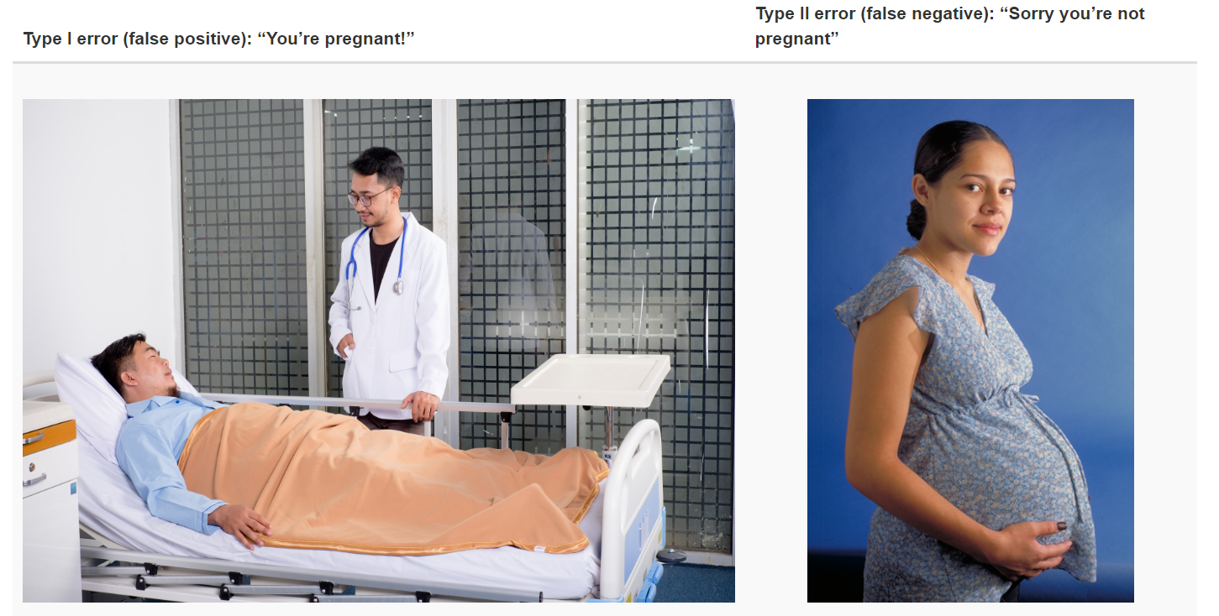
Type I and type II errors

Slide 11
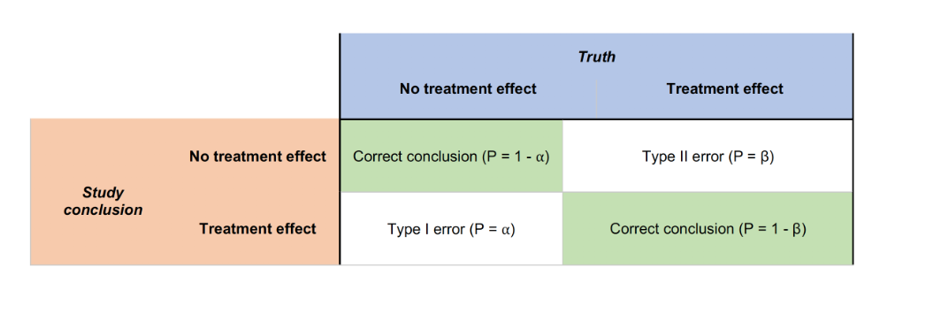
Type I and type II errors
Type I error: controlled by the α value. Often set to 0.01 (1%) or 0.001 (0.1%) in RNA-seq experiments
Type II error: controlled by the β value. (1−β) will give you the power of your analysis. Should be set to 70 or 80% to detect 70 or 80% of the differentially expressed genes. The number of biological replicates might be hard to reach in practice for RNA-seq experiments.

Slide 12
Power analysis: how many samples do I need?
RNA-seq experiments often suffer from a low statistical power. A low statistical power reflects type II error. From Button et al. (2013) “Power failure: why small sample size undermines the reliability of neuroscience”:
[low power entails that] you are missing “true effects” and there are many false negatives: genes that you should have been called differential but are not. It also affects the positive predictive value (PVV) of your findings which is the probability that a differential gene (p < 0.01) is a real true finding. Power is therefore linked to the ability to claim “true findings”.
The number of replicates is one of the critical parameter related to the power of an analysis. But first, let’s discuss what you understand by “replicates”.

Slide 13
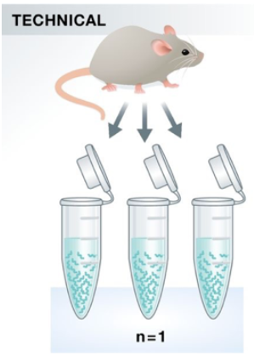
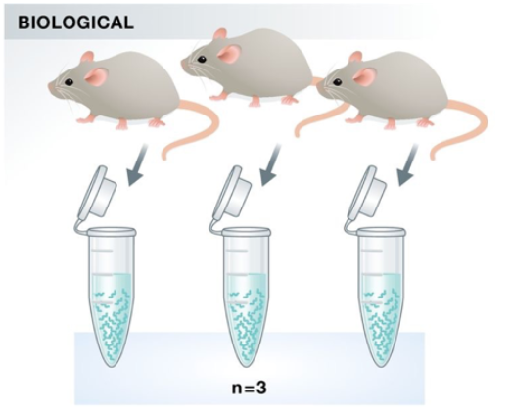
Technical replicates: use the same biological sample to repeat the technical or experimental steps in order to accurately measure technical variation and remove it during analysis.
Biological replicates use different biological samples of the same condition to measure the biological variation between samples.

Slide 14
For RNAseq, technical replicates are unneccessary
Biological replicates are absolutely essential
For differential expression analysis, the more biological replicates, the better the estimates of biological variation and the more precise our estimates of the mean expression levels.
This leads to more accurate modeling of our data and identification of more differentially expressed genes.

Slide 15
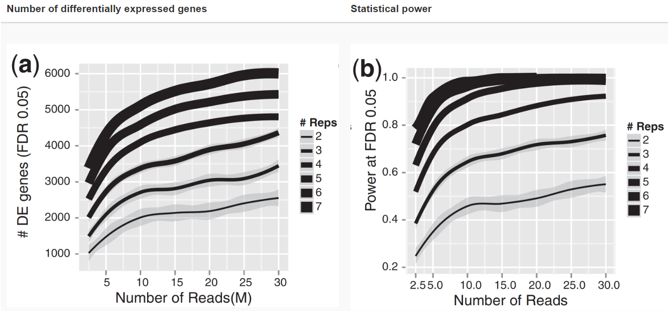
Power analysis for RNA-seq
Note that an increase in the number of replicates tends to return more DE genes than increasing the sequencing depth. Therefore, generally more replicates are better than higher sequencing depth, with the caveat that higher depth is required for detection of lowly expressed DE genes and for performing isoform-level differential expression.
Replicates are almost always preferred to greater sequencing depth for bulk RNA-Seq. However, guidelines depend on the experiment performed and the desired analysis. Below we list some general guidelines for replicates and sequencing depth to help with experimental planning:
As the two figures above illustrates, biological replicates are of greater importance than sequencing depth, which is the total number of reads sequenced per sample. The figure shows the relationship between sequencing depth and number of replicates on the number of differentially expressed genes identified

Slide 16
General gene-level differential expression:
ENCODE guidelines suggest 30 million SE reads per sample (stranded).
15 million reads per sample is often sufficient, if there are a good number of replicates (>3).
Spend money on more biological replicates, if possible.
Generally recommended to have read length 50 - 75 bp
Gene-level differential expression with detection of lowly-expressed genes:
Similarly benefits from replicates more than sequencing depth.
Sequence deeper with at least 30-60 million reads depending on level of expression (start with 30 million with a good number of replicates).
Generally recommended to have read length 50 – 75 bp
Isoform-level differential expression:
Of known isoforms, suggested to have a depth of at least 30 million reads per sample and paired-end reads.
Of novel isoforms should have more depth (> 60 million reads per sample).
Choose biological replicates over paired/deeper sequencing.
Generally recommended to have read length >= 50 bp, but longer is better as the reads will be more likely to cross exon junctions
Perform careful QC of RNA quality. Be careful to use high quality preparation methods and restrict analysis to high quality RIN # samples.
Other types of RNA analyses (intron retention, small RNA-Seq, etc.):
Different recommendations depending on the analysis.
Almost always more biological replicates are better!

Slide 17
Technical replicates: use the same biological sample to repeat the technical or experimental steps in order to accurately measure technical variation and remove it during analysis.
Biological replicates use different biological samples of the same condition to measure the biological variation between samples.
In the days of microarrays, technical replicates were considered a necessity; however, with the current RNA-Seq technologies, technical variation is much lower than biological variation and technical replicates are unneccessary.
In contrast, biological replicates are absolutely essential for differential expression analysis. For mice or rats, this might be easy to determine what constitutes a different biological sample, but it’s a bit more difficult to determine for cell lines. This article gives some great recommendations for cell line replicates.
For differential expression analysis, the more biological replicates, the better the estimates of biological variation and the more precise our estimates of the mean expression levels. This leads to more accurate modeling of our data and identification of more differentially expressed genes. This is also reflected for statistical power. More reads marginally affect your ability to differential genes while increasing the number of biological replicates has a strong effect.

Slide 18
Best practices for experimental design
In a typical biological experiment, you will encounter various sources of variation that are either:
desirable because they are part of your experimental factors. These are typically the one you first think of when you design your experiment.
undesirable (unwanted) because you are not interested in them. Although you might not list them, they will still affect the outcome of your experiment.

Slide 19
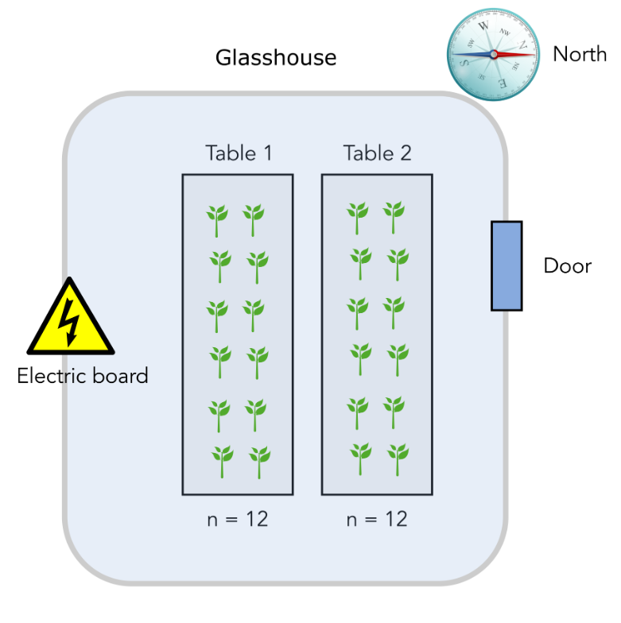
A case study
experimental design to study a disease assay experiment.
Goal is to measure the effect of a plant pathogen called “Designus malatesta” on two plant genotypes: one resistant to the pathogen (labelled “R”) and one susceptible (labelled “S”)
The experiment consists of a total of 24 individual plants that are placed on two tables in a greenhouse compartment. Each table can accomodate 12 plants

Slide 20
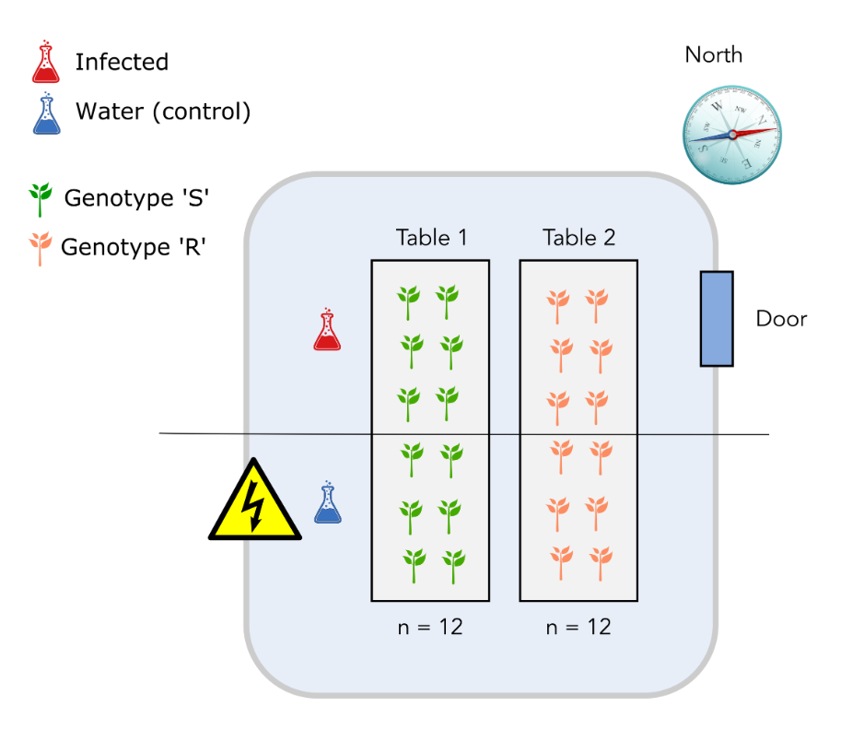
Design number 1
The major issue here is that it is not possible to distinguish the “table effect” (undesirable) from the “genotype” effect since all S genotypes are on table 1 while all R genotypes are on the table 2. The “table effect” can be assimilated to a temperature effect since plants and pathogen on table 1 might experience a warmer temperature than plants and pathogen on table 2.

Slide 21
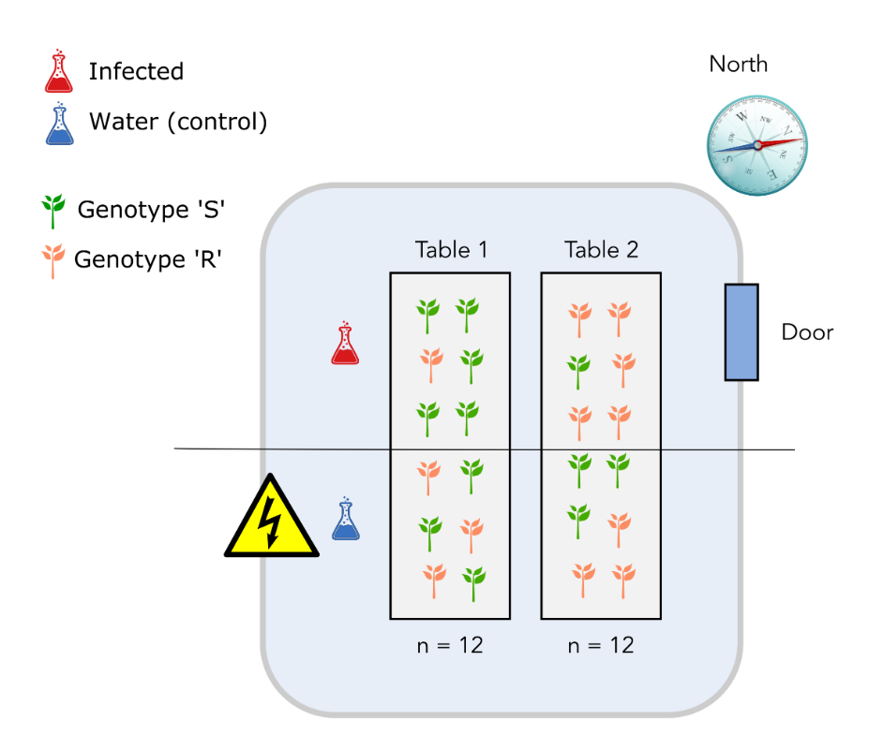
Design number 2
The major issue with this design is that we might end up with an unbalanced number of genotypes from the S or R class on each table. It would be preferable to have the same number on each genotype. The fact that the infection will also happen for plants located on “half tables”, a yet unidentified source of variation might not be taken into account.

Slide 22
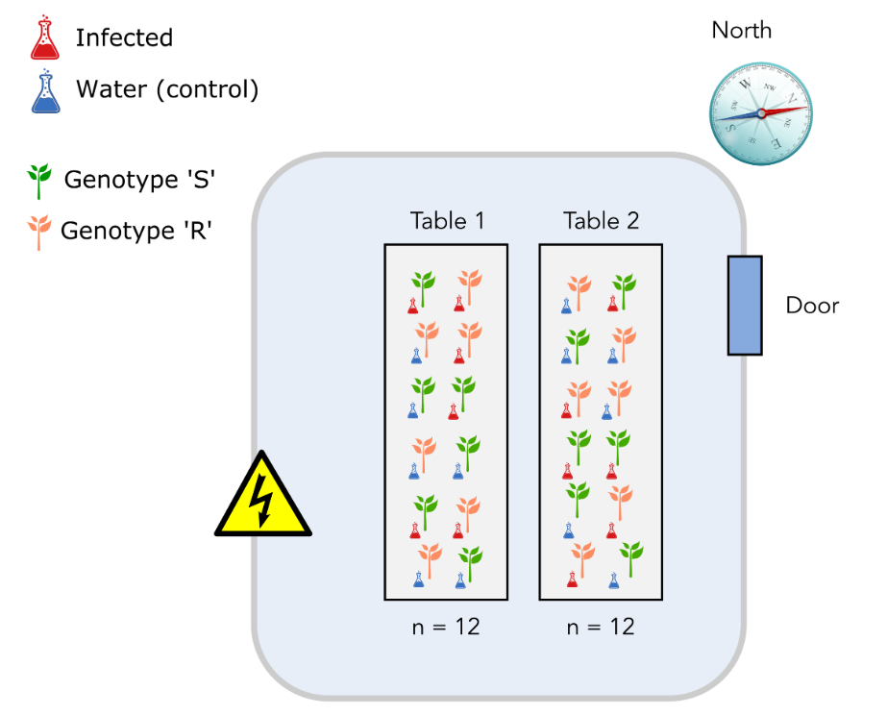
Design number 3: completely randomized block design
Plant genotypes S and R in equal numbers.
Infection or mock (water) conditions in equal numbers. Both plant genotypes and treatment positions will also be randomized on each table.

Slide 23
Conclusion
If you record and control both desirable and undesirable source of variation, you are then able to include them into your statistical model and account for them. This in turns allow you to “sort the wheat from the chaff” and separate undesirable (e.g. temperature) sources of variation from desirable sources (e.g. treatments, genotypes, etc.)

Slide 24
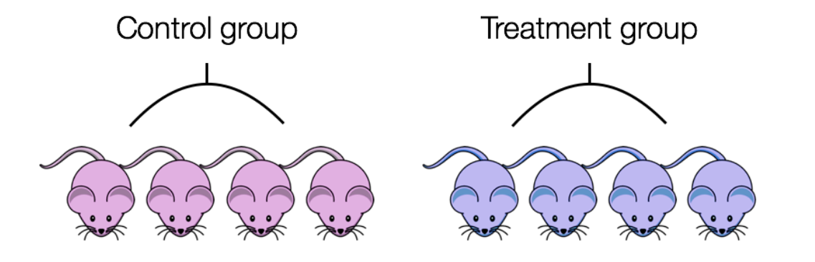
Sex confounded with treatment
A confounded RNA-Seq experiment is one where you cannot distinguish the separate effects of two different sources of variation in the data.
We could not differentiate the effect of treatment from the effect of sex.

Slide 25
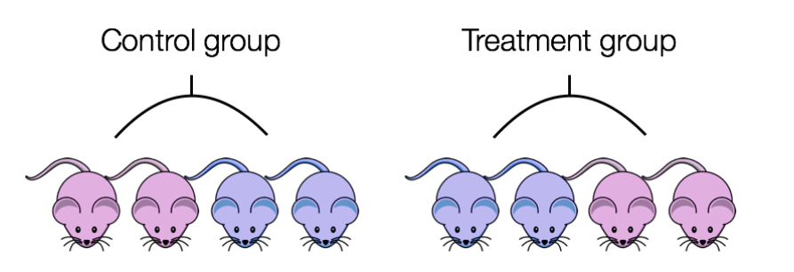
To AVOID confounding:
Ensure animals in each condition are all the same sex, age, litter, and batch, if possible.
If not possible, then ensure to split the animals equally between conditions

Slide 26
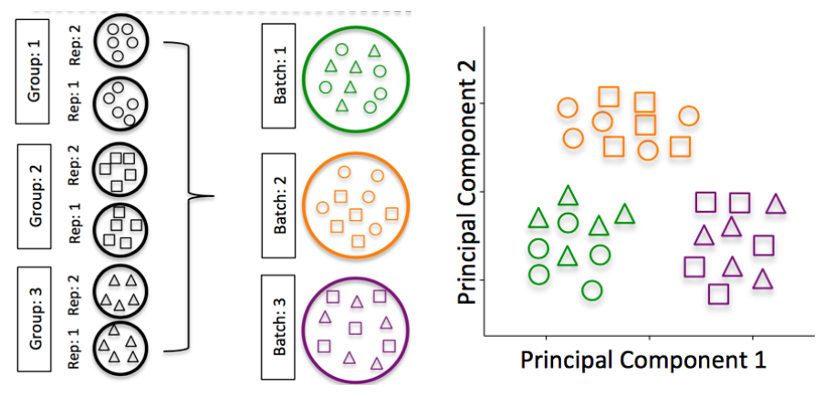
RNA isolation batch effects
Batch effects are a significant issue for RNA-Seq analyses, since you can see significant differences in expression due solely to the batch effect.

Slide 27
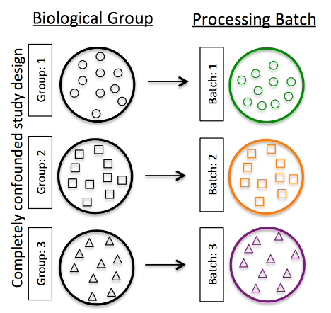
Do NOT confound your experiment by batch:

Slide 28
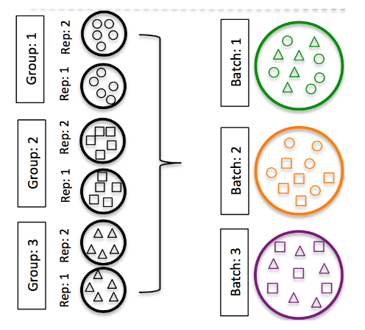
DO split replicates of the different sample groups across batches

Slide 29
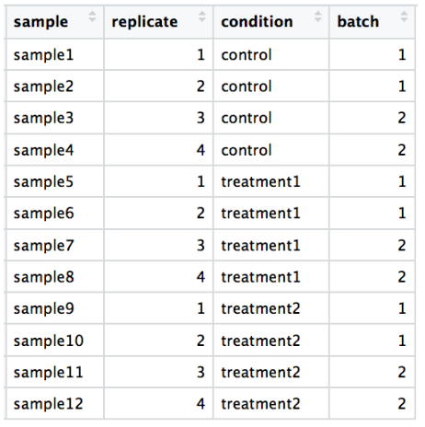
DO include batch information in your experimental metadata

Slide 30
The three principles of a good experimental design
Randomization: when you assign treatments to experimental units (e.g. a single plant). This should remove undesired and sometimes unknown bias coming from an unidentified source of variation (e.g. different temperatures in the same greehouse).
Replication: by repeating the same minimal experiment more than once, you can estimate the error due to the experimenter manipulation, increase the precision by which you estimate the variable of interest and therefore better estimate your treatment effect.
Blocking can help to reduce variability unexplained in one’s model. If your group consist of male and female individual, there is a chance that they will not respond in the same way to a given treatment. Therefore, “sex” should be a blocking factor in this case. In our case study, “table” was a blocking factor necessary to account for variability in temperature.

Slide 31
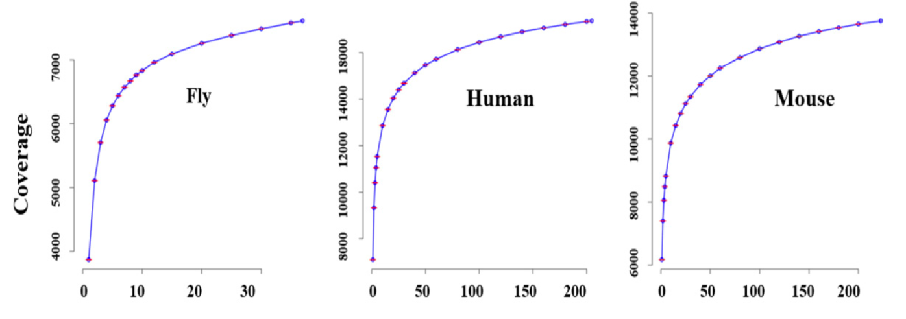
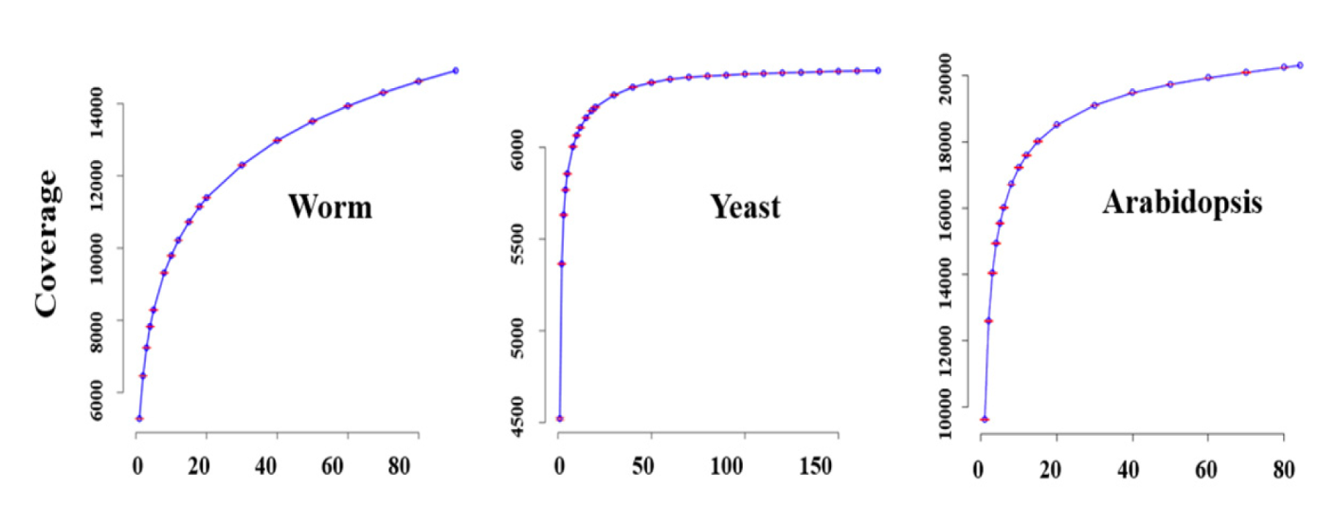
Other points relevant to RNA-seq
Sequencing depth, how many reads per sample do I need?
In a study on the impact of sequencing depth on the number of genes detected, have shown the increasing sequencing depth (number of reads) does not greatly improve the number of detected genes.
For most species and Arabidopsis in particular, a number around 15M single reads should be enough.
As we have seen earlier in this episode, the most important aspect is to maximise the number of biological replicates

Slide 32

Other points relevant to RNA-seq
Pooling of samples; yes or no
Yes if absolutely necessary. For instance, you are collecting roots from very young seedlings and you won’t have enough material to isolate RNA.
One reason not to pool is that you cannot identify potential outliers.
Sample pooling: Try to avoid pooling of individuals/experiments, if possible; however, if absolutely necessary, then each pooled set of samples would count as a single replicate. To ensure similar amounts of variation between replicates, you would want to pool the same number of individuals for each pooled set of samples

